Slide 1
UGBA 141 Production and Operations Management
SCM II Bullwhip Effect
Emerging III Knowledge Sharing
Professor Park Sinchaisri
Notes:
Agenda
Capability Analysis + Six Sigma
Ritz-Carlton Case
Service Excellence

Slide 2
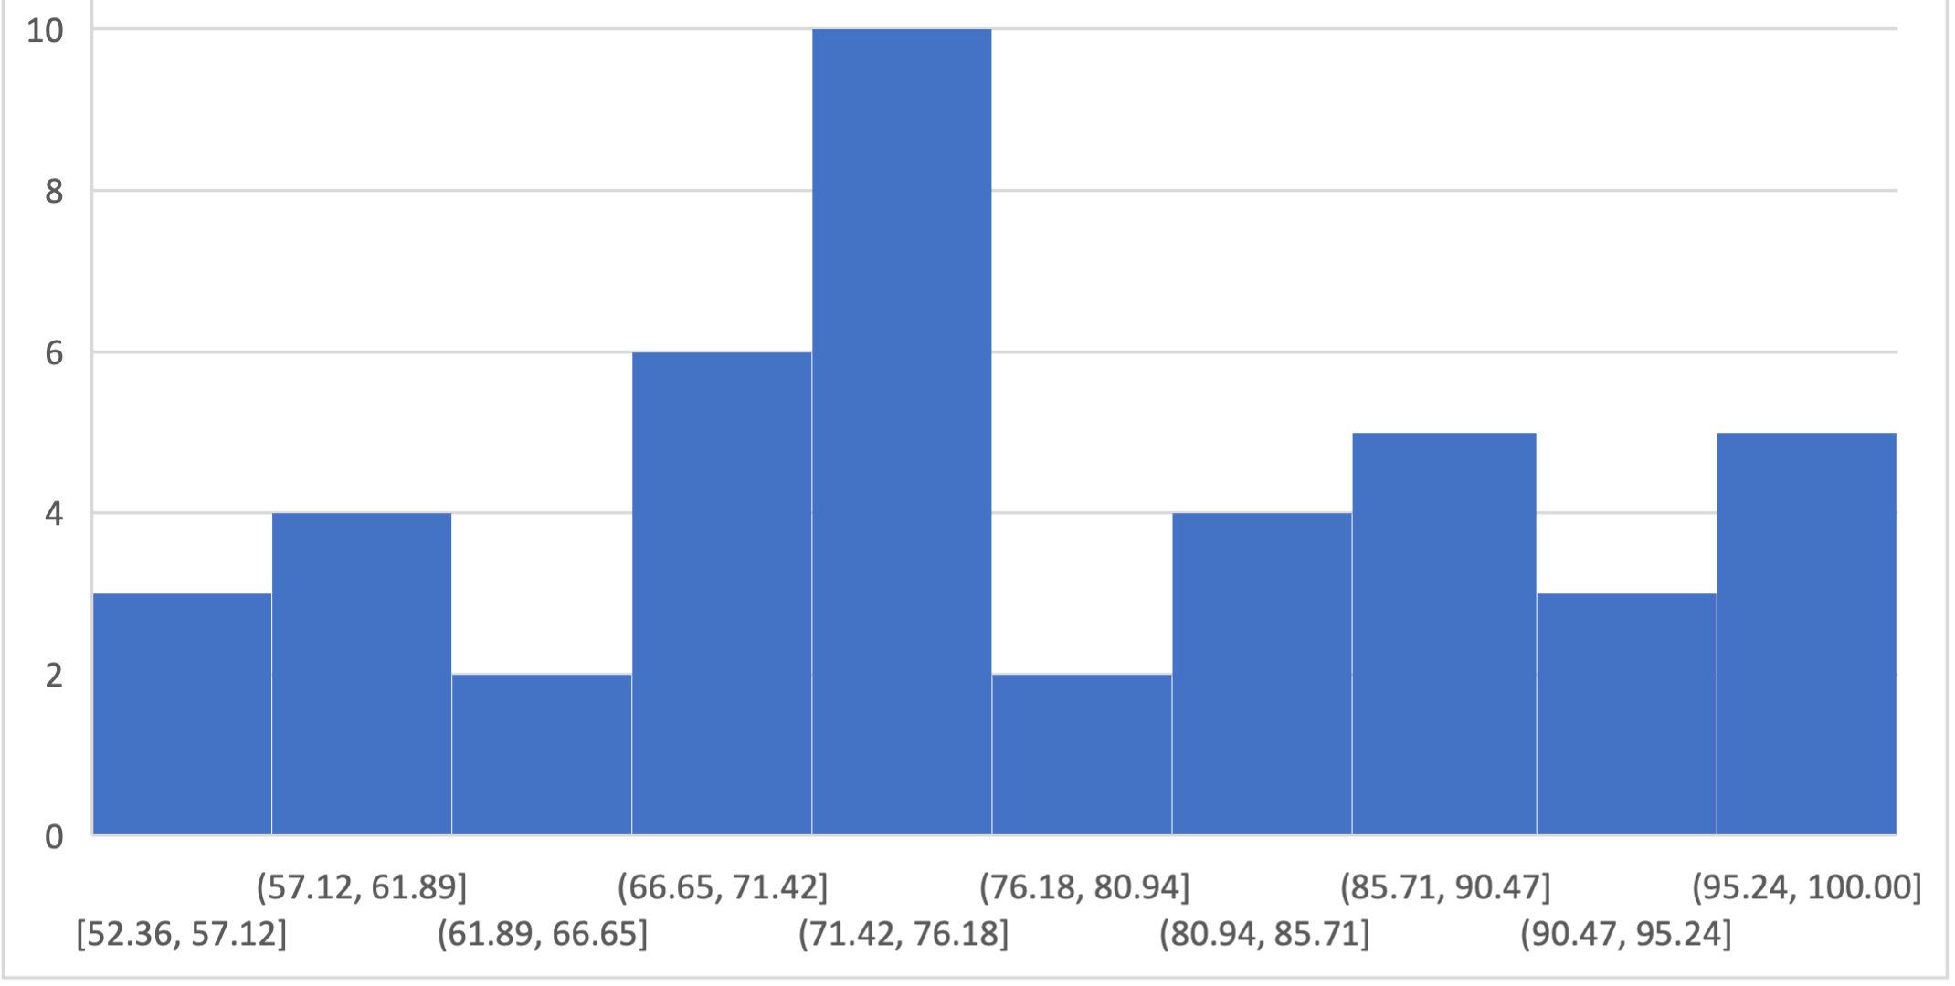
Course Announcement
Midterm was harder than I intended… we curved! Regrade request on Gradescope by Friday 2pm Take advantage of Friday discussions, OHs, Discord
HW4 is optional to give you time for projects If skipped, HW1-3 + 5 will be 3.75% each If submitted (+ 1 extra week), each HW will be 3% (per syllabus)
No Discussion This Friday. Enjoy Spring Break!
Mean: 77%
Median: 74.175%
SD: 13.17%
Min: 52.36%
Max: 100%

Slide 3
Revisit SCM I: Beer Game

Slide 4
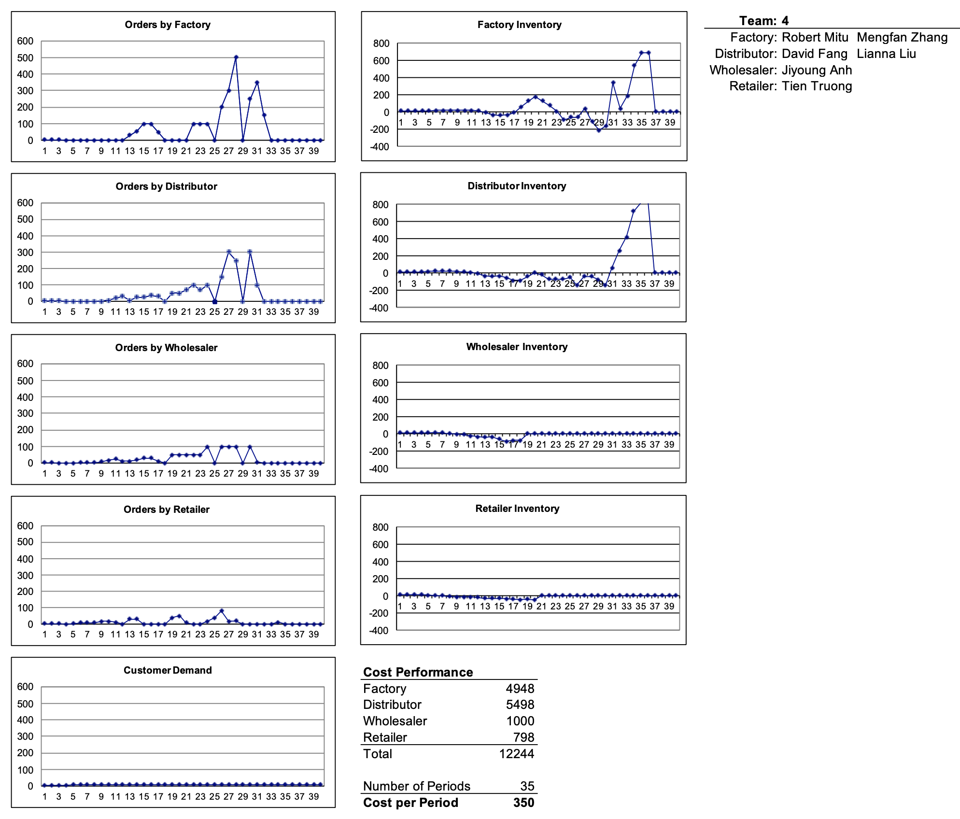


Slide 5
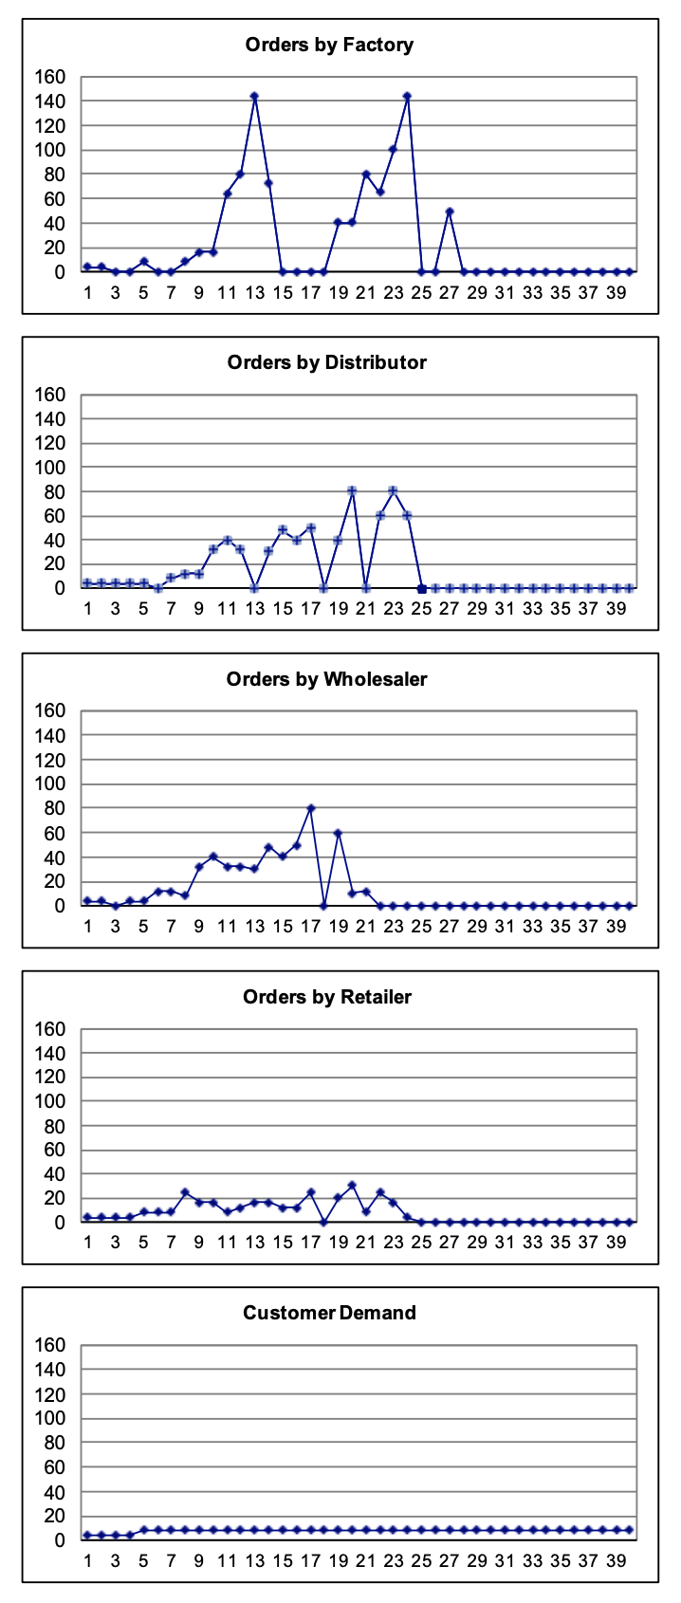
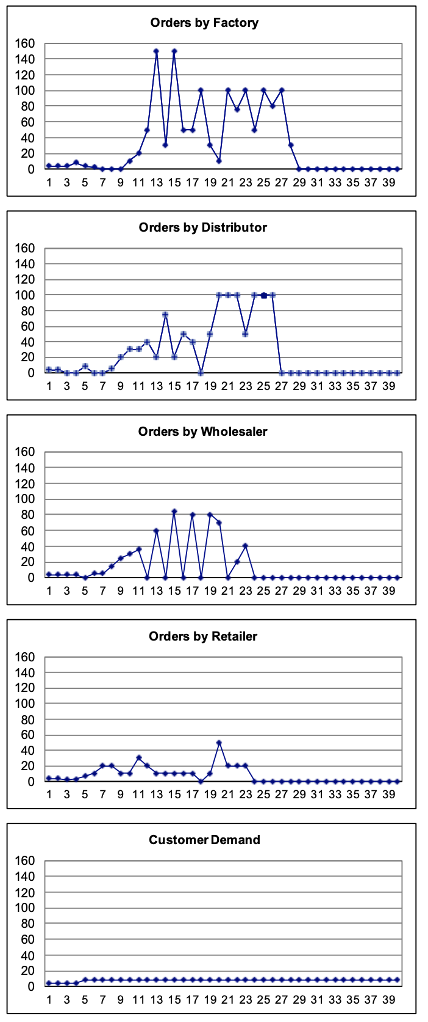
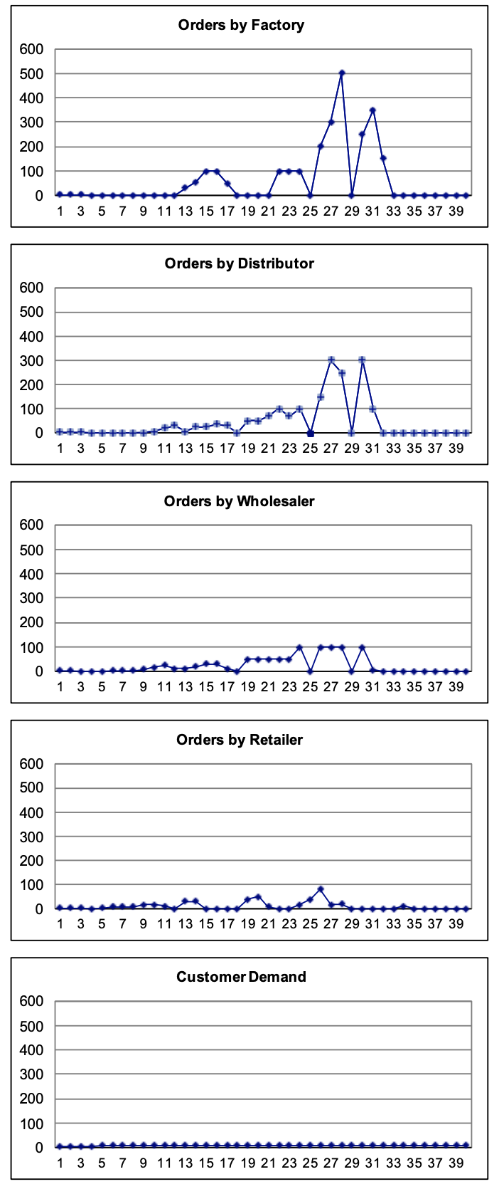
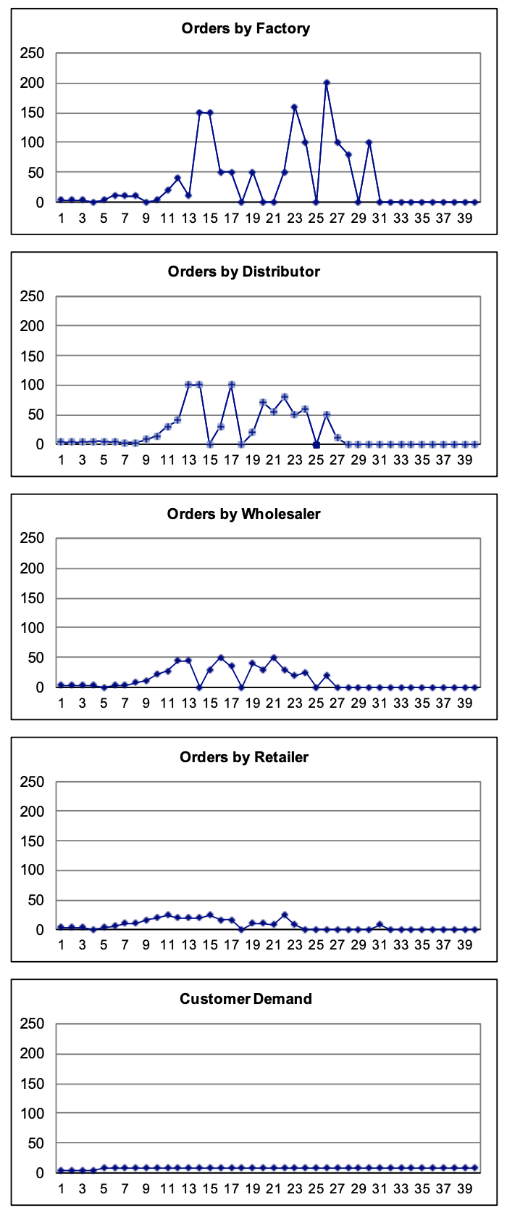
Bullwhip Effect (Info Distortion)
Team 2
Team 3
Team 4
Team 5

Slide 6
Supply Chain Management
Information: Capacity, promotion plans, delivery schedules
Material: Raw materials, intermediate products, finished goods
Finance: Credits, consignment, payment terms, invoices
Supply
Production
Distribution
Retail
Information: Sales, orders, inventory, quality, promotion plans
Material: Returns, repairs, servicing, recycling, disposal
Finance: Payments, consignment

Slide 7
Bullwhip Effect Info Distortion
CONSUMER PRODUCT EXAMPLE
manufacturer orders
distributor orders
retailer orders
consumer sales

Slide 8

Bullwhip Effect Tech SC
PERSONAL COMPUTER EXAMPLE
consumer sales
retailer orders

Slide 9
Bullwhip Effect Info Distortion
Bullwhip Effect: Order variability increases as move up the supply chain from consumers to suppliers
Demand information is distorted; upstream decision makers do not see true picture of demand
supplier
manufacturer
distributor
retailer
consumer

Slide 10
Bullwhip Effect Consequences
Excessive inventory -> Markdowns
Insufficient inventory -> Lose sales, penalty, lost customers

Slide 11


Bullwhip Effect Tech SC
Changes in demand
Bullwhip Effect in a Downturn: In 4th quarter of 2008,
consumer purchases of electronics gear fell 8%
shipments of chips going into that gear fell 20%
Semiconductor Equipment
Personal Computers
Semiconductor
Annual percentage changes in demand (in $s) at three levels of the semiconductor supply chain: personal computers, semiconductors and semiconductor manufacturing equipment.

Slide 12

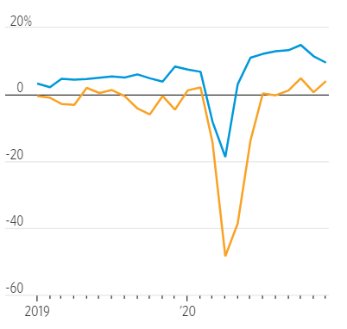
Bullwhip Effect Covid-19 Shock
“Supply chains typically get beaten up during recessions. When demand improves, suppliers respond with an outsize increase in production to restock empty warehouses and assembly plants. The so-called bullwhip effect ripples all along supply chains, generating unusually large orders for suppliers that are far from end customers.”
Bullwhip Effect in a Downturn: In April 2020,
purchases of durable goods fell 18%
industrial production of durable goods fell 48%
Purchases
Industrial Production
“This time, the bullwhip effect is even more pronounced because demand for consumer products has been extraordinarily high.“
Notes:
This slide: specific product
Shipments: inbound (orders to suppliers)
Also:
98% of products exhibit a bullwhip effect
Median shipment SD is 4.6 times the median sales SD
4-pack of 125ml Wangwang brand strawberry milk shake sold in a Jiangsu store
Bullwhip makes it harder for suppliers to forecast demand

Slide 13
Bullwhip Effect Causes
Reactive and over-
reactive ordering
Bullwhip
Effect
Causes
Trade promotions and forward buying
Shortage gaming

Slide 14
Causes Reactive/Over-reactive
Each location forecasts demand to determine shifts in demand process
How should a firm respond to a “high” order?
Is this a signal of higher future demand or just a random variation in current demand?
Hedge by assuming this signal higher future demand, i.e., order more than usual
Rational reactions at one level propagate up the supply chain
Unfortunately, it is human (all too human) to over react, thereby further increasing the bullwhip effect

Slide 15

Causes Trade Promotions
SOUP EXAMPLE
Quantity
consumer sales
consumer sales
retailer orders
Supplier gives retailer a temporary discount (trade promotion)
Retailer purchases based on trade promotions (forward buying)
“High-low” pricing (“trade promotion”) encourages “forward buying,” leading to higher variability in orders

Slide 16
Causes Shortage Gaming
Setting:
Retailers submit orders for delivery in future period
Supplier produces
If supplier production is less than orders, orders are rationed, i.e., retailer are “put on allocation”
…to secure a better allocation, retailers inflate their orders, i.e., order more than they need (place “phantom orders”) and then cancel these orders when adequate supply is restored…
…so retailer orders do not convey good information about true demand

Slide 17
Causes Shortage Gaming (cont.)
“But they are self-serving, so they accelerate their orders, stockpiling inventory to hedge against a potential upstream stock-out. We estimate that these inventory runs account for about a 10% of the bullwhip effect.”
Bray et al. 2019. Ration Gaming and the Bullwhip Effect.

Slide 18
Counteracting Bullwhip Effect
Counter-Strategies
Counter-Strategies
Share sell-through data
Vendor Managed Inventory (VMI):
delegate stocking decisions
Coordinate with retailers to spread
deliveries evenly
Restructure incentives
Every day low pricing
Restructure allocation rules
Share sell-through demand data
Vendor managed inventory (VMI)
Vertical control/integration
Better demand forecasting (e.g., moving averages)
Reactive and over-
reactive ordering
Bullwhip
Effect
Causes
Trade promotions and forward buying
Everyday low pricing
Smooth out promotions
Time promo in low demand times
Discount on sell-thru instead of sell-in
Shortage gaming
Restructure allocation rules
Allocate based on past sales

Slide 19
Bullwhip Effect Takeaways
Information distortion through the bullwhip effect can significantly undermine supply chain efficiency
Devising effective strategies to counter the bullwhip effect requires understanding of underlying causes
Beer game demonstrates amplification of variability and consequences of over-reacting to uncertainty

Slide 20

Case: Danone

Slide 21









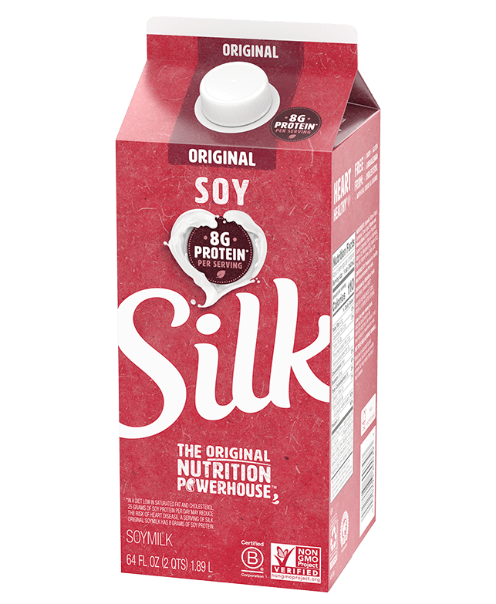

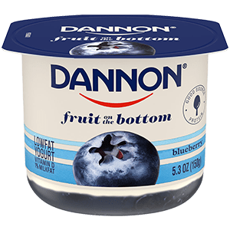
Danone Background
HQ in Paris, 100,000 employees across 120 countries
Innovations: Health through food, sustainability, social impact
“Our ambition is to provide diverse and varied learning opportunities to all employees around the world.”
Networking Attitude novel approach to knowledge management
Informal knowledge marketplaces and sharing networks
Designed to break down geographic and functional silos to facilitate P2P info sharing and build relationships between managers facing similar challenges

Slide 22
Danone Challenges
What problem are they trying to solve?
Difficulties sharing knowledge in decentralized, hierarchical org
Lack of P2P communication between managers
Smaller than competitors; needs to be fast to market to compete
Why does sharing of ideas often not occur naturally?
Competition between product lines/regions; “knowledge is power”
Disincentive to share effective practices/solutions to ops problems
Decentralization: don’t know whom to ask for advice, can it transfer?
Lack of formal incentives to share info; recognition/credit
What kinds of knowledge are being shared?

Slide 23
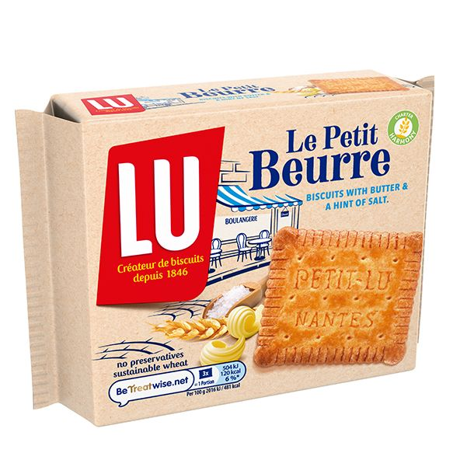
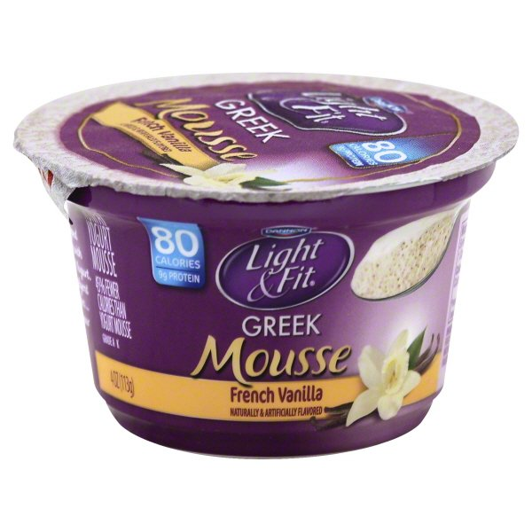
Danone Good Practices
(Exhibit 3 in the case)
Operations
In Brazil, making a 0% fat mousse is difficult and would take a lot of time and money
Solution: Borrow the development tech from Danone Canada that already had a market leading product
Result: Save 6 months of R&D and avoid a $20,000 test
Canada -> Brazil
Marketing
In Finland, people don’t eat biscuits for breakfast, so their breakfast biscuit was not selling
Solution: French breakfast concept was repositioned into a biscuit for little hungers in the mid-morning
Result: Biscuit became the best launch in Finland in 5 years
France -> Finland

Slide 24
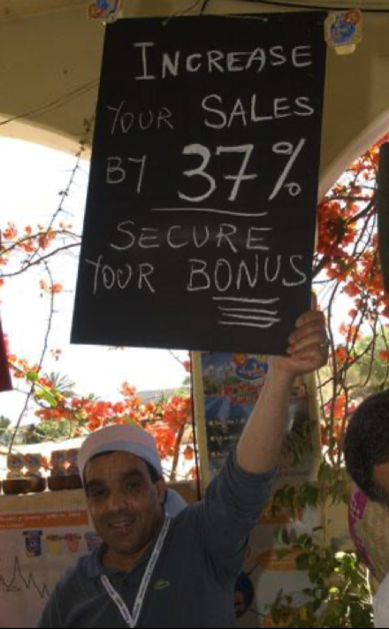



Danone Marketplaces

Slide 25
Danone Analysis
Strength
Sharing best practices creates efficiencies, no “reinvent the wheel”
Creates connected community in decentralized firm, breaks down silos
Creates culture of knowledge transfer
Mitigates managers’ ‘not sharing’
Works even w/o incentives
Role-play to break the ice alleviates intimidation, flattens organization, reduces inhibitions around asking questions and sharing ideas
Weaknesses
Too cartoonish and unnatural
Face-to-face is inefficient; no IT
Disorganized for sharing info
Lack of formal incentives
Hard to measure effectiveness
Notes:
Promotes efficiencies by avoiding “reinventing the wheel”
Facilitates savings or revenue increases not captured by accounting
Allows “free consulting”
Facilitates faster communication and problem solving, faster action

Slide 26







Danone Make Sense for Others?
Where it helps:
Firms facing communication challenges
Decentralized organizations: benefits of autonomy can bring the downside of insulated units and undermine sharing between units/employees
Informal sharing of practical knowledge that is hard to codify/put in a manual
Where it doesn’t help:
Requires specific organizational culture
Firms that are less flexible, smaller, or require more rigid, documented practices (e.g., highly regulated)
Conducive to a more codified and systematic approach of sharing

Slide 27


Knowledge Sharing
Codification (documenting knowledge)
when knowledge needs to be scalable, available in real time
when replication is likely
high personnel turnover
highly regulated industries
to overcome obstacle of distance between personnel
Personalization (human networking)
when bureaucracy/IT is a barrier
when F2F is needed to explain ideas and motivate action (“when knowledge is not uploadable”)
to transfer contextual and tacit knowledge, ideas about solutions to specific situations
to instill sense of belonging

Slide 28
Danone Takeaways
Knowledge management is a challenge for large organizations
Networking Attitude doesn’t completely solve knowledge problem, but it takes important steps towards creating a culture in which sharing of practical knowledge is encouraged and natural.
Low-cost approach to tapping the extensive operational knowledge in individuals, and avoiding expensive ways to solve problems (e.g., hiring consultants or “reinventing the wheel.”)
Go deeper across functions, make it a habit, empower/alignment
Go wider external bridges, improve SC + customer relationships
Go richer focus on new processes/products, full potential of HC

Slide 29
Preparing for Next Class

Slide 30
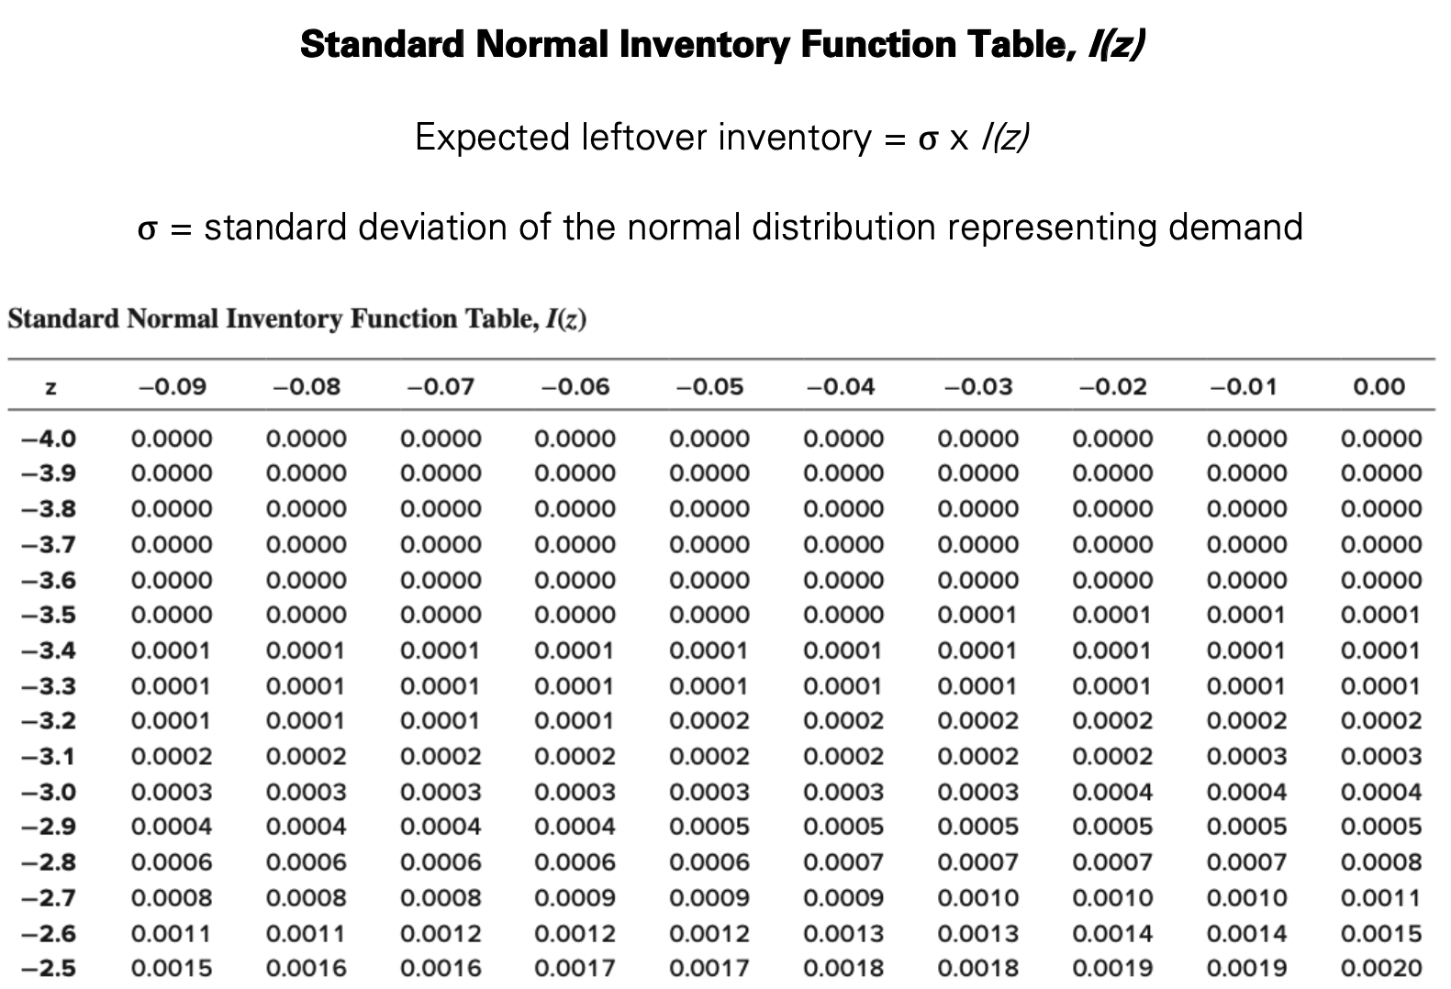
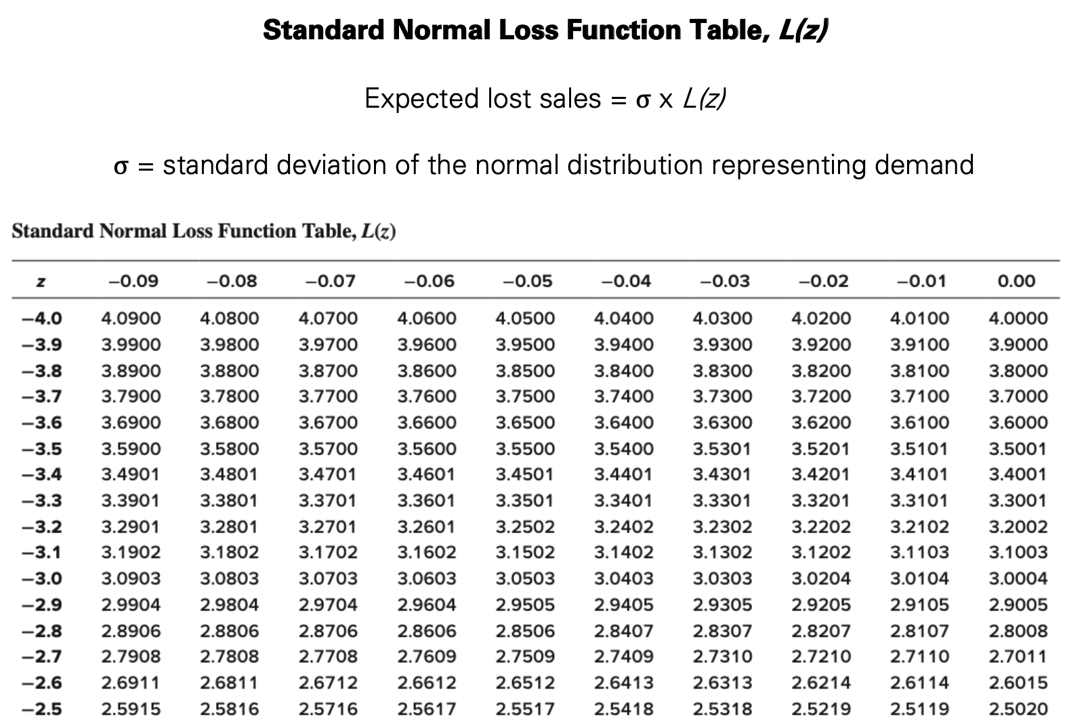
Inventory/Loss Functions
Demand < Forecast
=> Leftover
Demand > Forecast => Lost sales
Expected Demand

Slide 31
Expected Leftover/Lost Sales
Sales + Leftover Inventory = Q
Leftover Inventory = Q – Sales
E[Leftover] = Q – E[Sales]
= sigma * I(z)
Look up from the I(z) Table
Excel: I(z) = NORMDIST(z,0,1,0) + z * NORMSDIST(z)
Sales + Lost Sales = Demand
Lost Sales = Demand – Sales
E[Lost Sales] = E[Demand] – E[Sales]
= mu – E[Sales]
= sigma * L(z)
Look up from the L(z) Table
Excel: L(z) = NORMDIST(z,0,1,0) – z*(1 – NORMSDIST(z))
E[Lost Sales] = mu – E[Sales]
= mu – Q + E[Leftover Inventory]

Slide 32
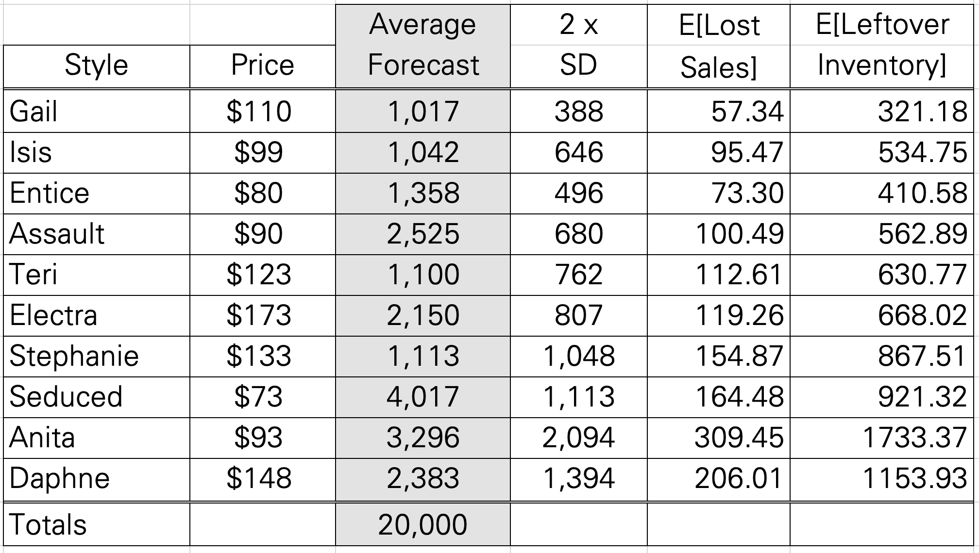
Practice Sport Obermeyer
Assume z = 0.68, compute E[Lost Sales] and E[Leftover Inventory]
I(z) = 0.8278, L(z) = 0.1478
Ex. The Gail style
E[Lost Sales]
= 388 x 0.1478
= 57.3464
E[Leftover]
= 388 x 0.8278
= 321.1864
If we had ordered Q such that (Q – 1017)/388 = 0.68

Slide 33


What’s Next
Meet with your project sponsor this week
No Friday Discussion This Week
Midterm Regrade Request by Friday 2pm
Optional HW4 available tomorrow, due April 5, 11:59pm
Prepare for SCM III (Wednesday)
Read: Sport Obermeyer
Report due tomorrow 11:59pm
Review Newsvendor model, E[Lost Sales], E[Leftover]

